Slide 1

RAJIV GANDHI UNIVERSITY
(A Central University)
RONO HILLS DOIMUKH, ITANAGAR
DEPARTMENT OF COMPUTER SCIENCE AND ENGINEERING
PROJECT PRESENTATION ON
TOURISM MANAGEMENT SYSTEM
SUBMITTED BY:
Mr. AJAY PRAJAPATI
Miss. TABA NUNU
UNDER THE GUIDANCE OF
BHASKAR JYOTI C.
(Assistant Professor)
Date: 13/06/2018
Notes:
This template can be used as a starter file to give updates for project milestones.
Sections
Right-click on a slide to add sections. Sections can help to organize your slides or facilitate collaboration between multiple authors.
Notes
Use the Notes section for delivery notes or to provide additional details for the audience. View these notes in Presentation View during your presentation.
Keep in mind the font size (important for accessibility, visibility, videotaping, and online production)
Coordinated colors
Pay particular attention to the graphs, charts, and text boxes.
Consider that attendees will print in black and white or grayscale. Run a test print to make sure your colors work when printed in pure black and white and grayscale.
Graphics, tables, and graphs
Keep it simple: If possible, use consistent, non-distracting styles and colors.
Label all graphs and tables.

Slide 2
CONTENT’Ss
1.INTRODUCTION
2.OBJECTIVE
3.DATA FLOW DIAGRAM
4. TABLES RELATIONSHIP
5. ER-DIAGRAM
6. SYSTEM DESIGN
Notes:
What is the project about?
Define the goal of this project
Is it similar to projects in the past or is it a new effort?
Define the scope of this project
Is it an independent project or is it related to other projects?
* Note that this slide is not necessary for weekly status meetings

Slide 3
INTRODUCTION
The tourism management system is a web based application.
The main purpose is to provide convenient way for a customer to book tour package, etc.
We developed this web application to over come from manual system.
Notes:
* If any of these issues caused a schedule delay or need to be discussed further, include details in next slide.

Slide 4
OBJECTIVE
This application is develop to provide best tourist services to the users.
Tourism Management System is developed to provide a view package platform where a tourist can find their best tour places according to their choices.
This system also helps to promote responsible and interesting tourism so that people can enjoy their holidays at their favourable places.
This system also helps to develop tourism with different cultures so that they enrich the tourism experience and build pride.
Notes:
Duplicate this slide as necessary if there is more than one issue.
This and related slides can be moved to the appendix or hidden if necessary.

Slide 5
ELEMENTS OF DFD
It represents external entity
It represents a process
It represents data flow
It represents data store/database

Slide 6
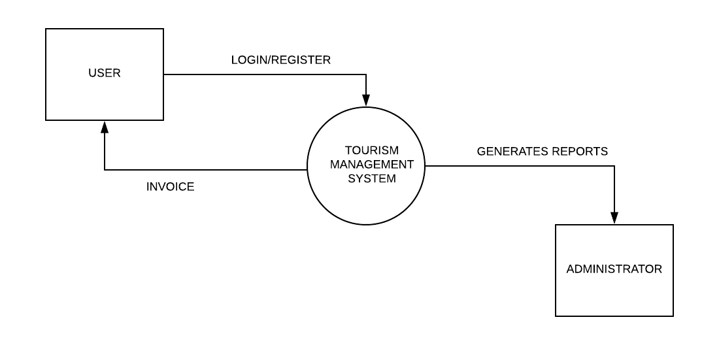
DATA FLOW DIAGRAM
(a). O LEVEL DFD/CONTEXT DIAGRAM
INPUT DATA

Slide 7
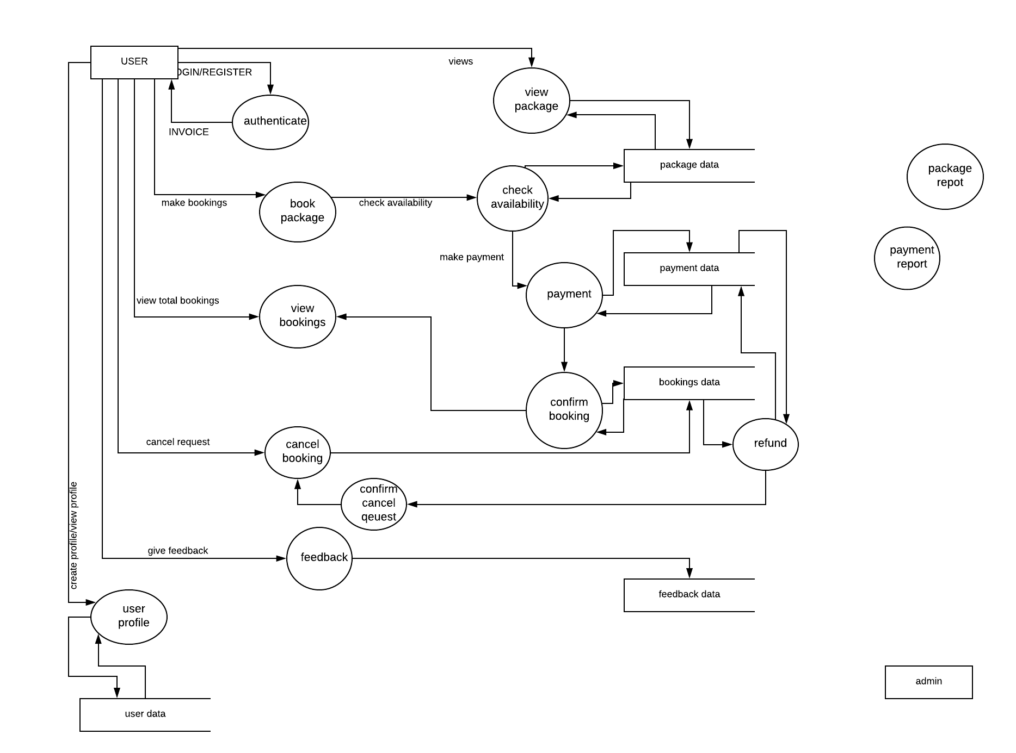
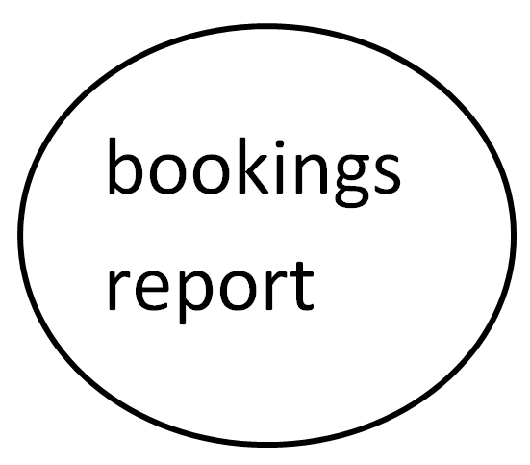
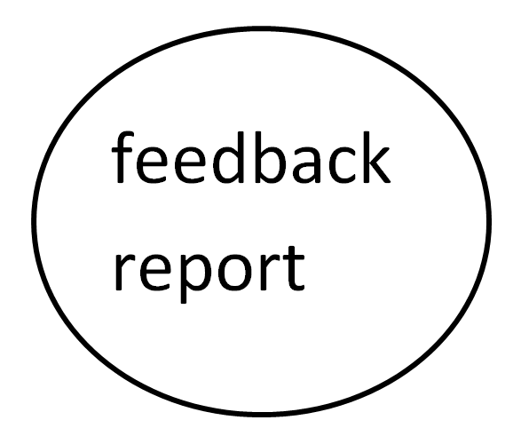
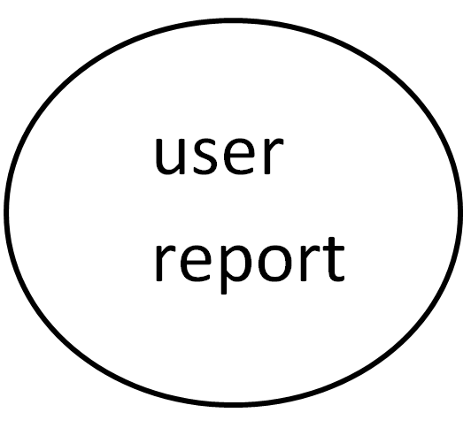
LEVEL 1 DFD
Login/register
User dashboard
(a). LEVEL 1 DFD

Slide 8
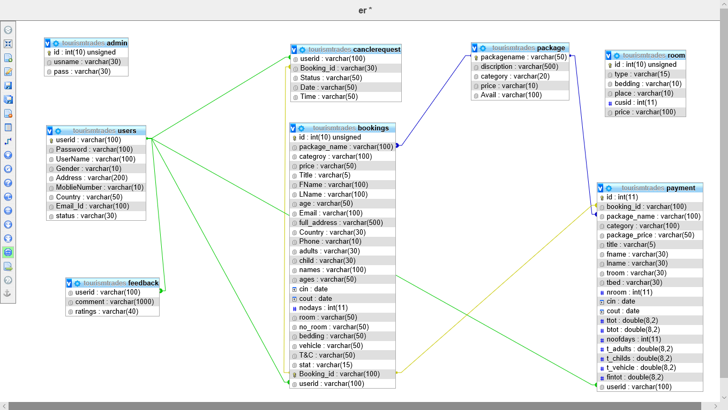
TABLES RELATIONSHIP

Slide 9
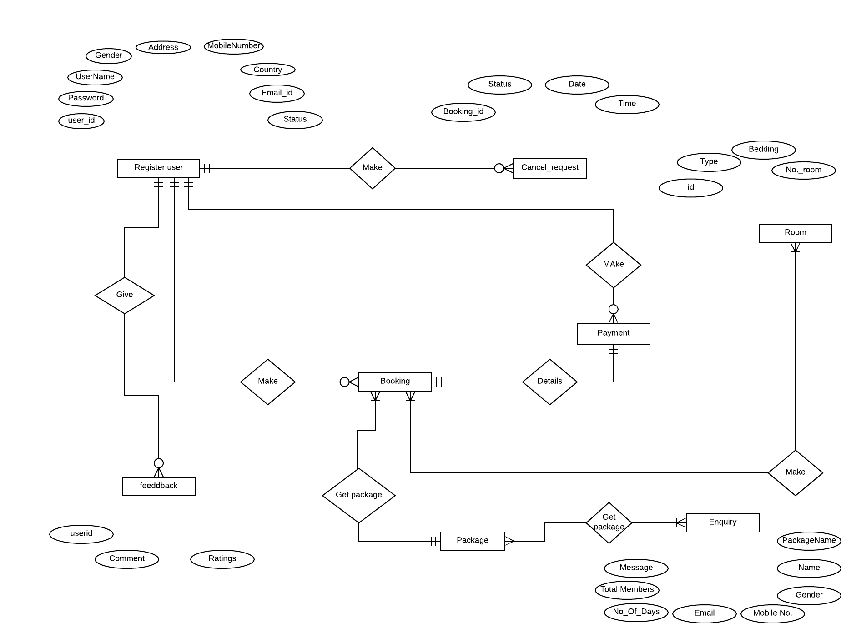
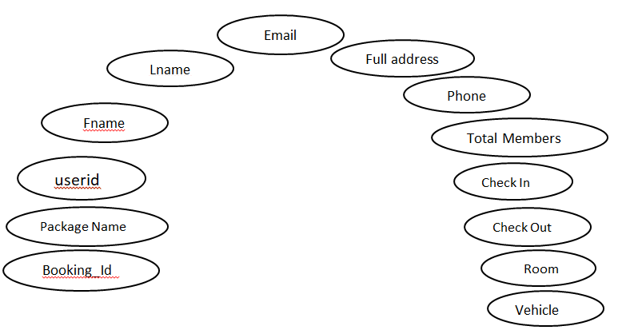
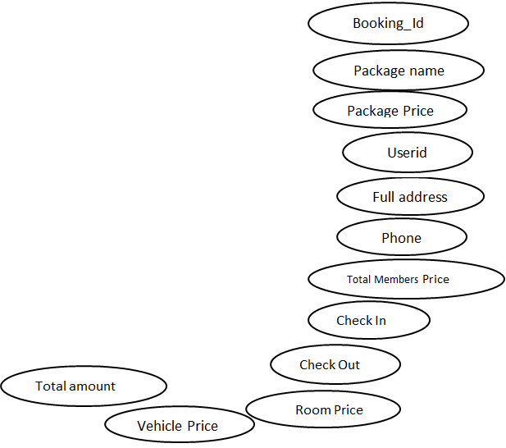
ER-DIAGRAM
Fname
userid
Booking_id
Make
Get Room
Package name
discription
available
Price
category

Slide 10
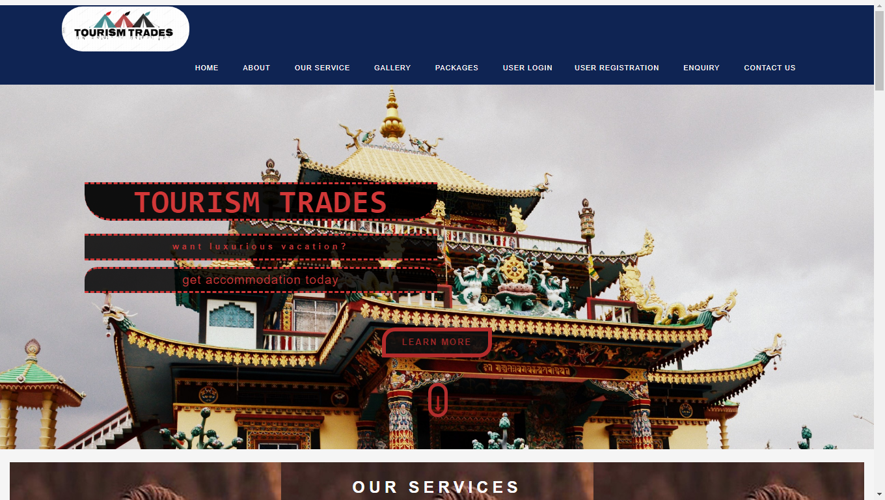
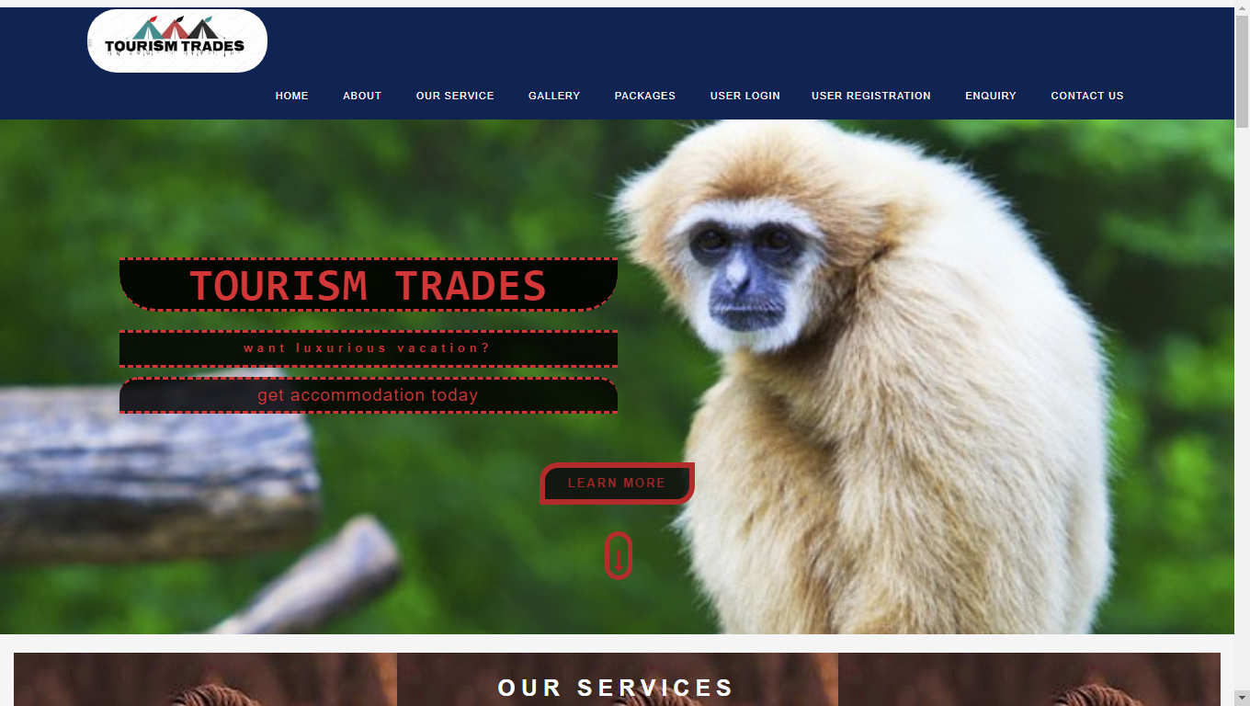
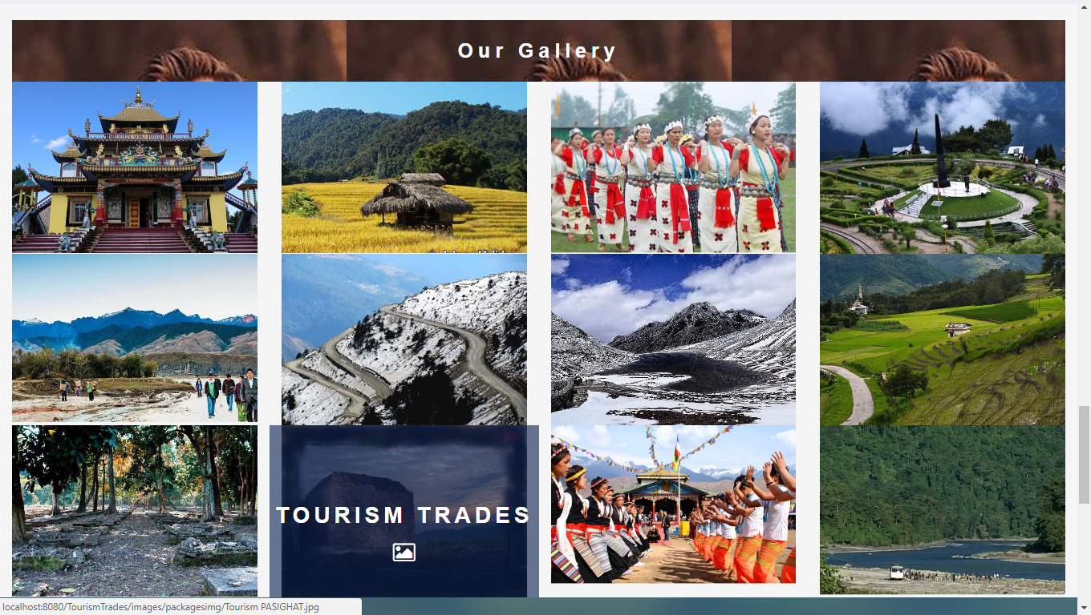
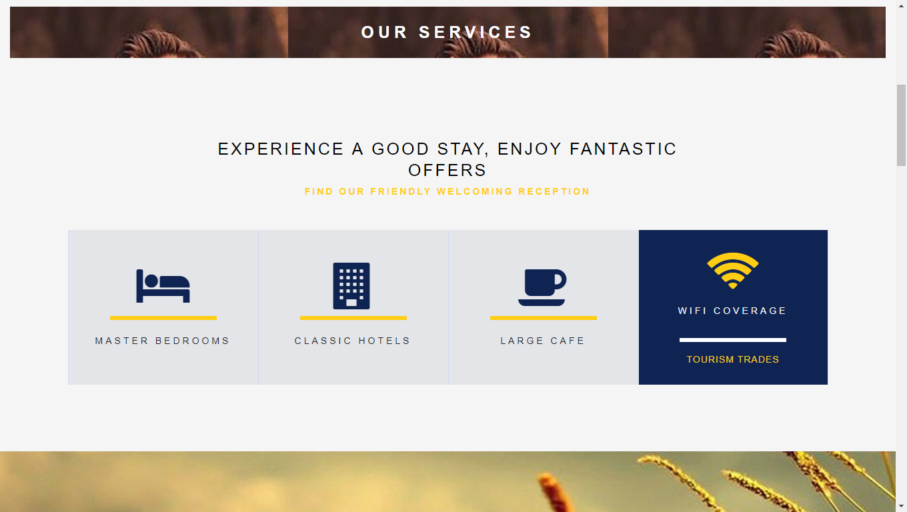
SYSTEM DESIGN

Slide 11
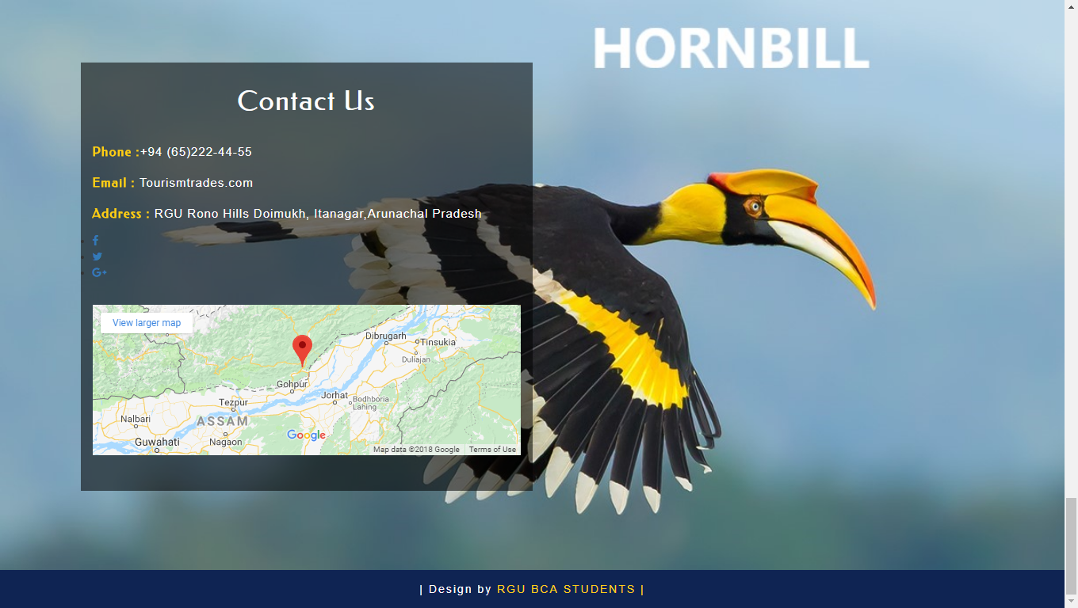
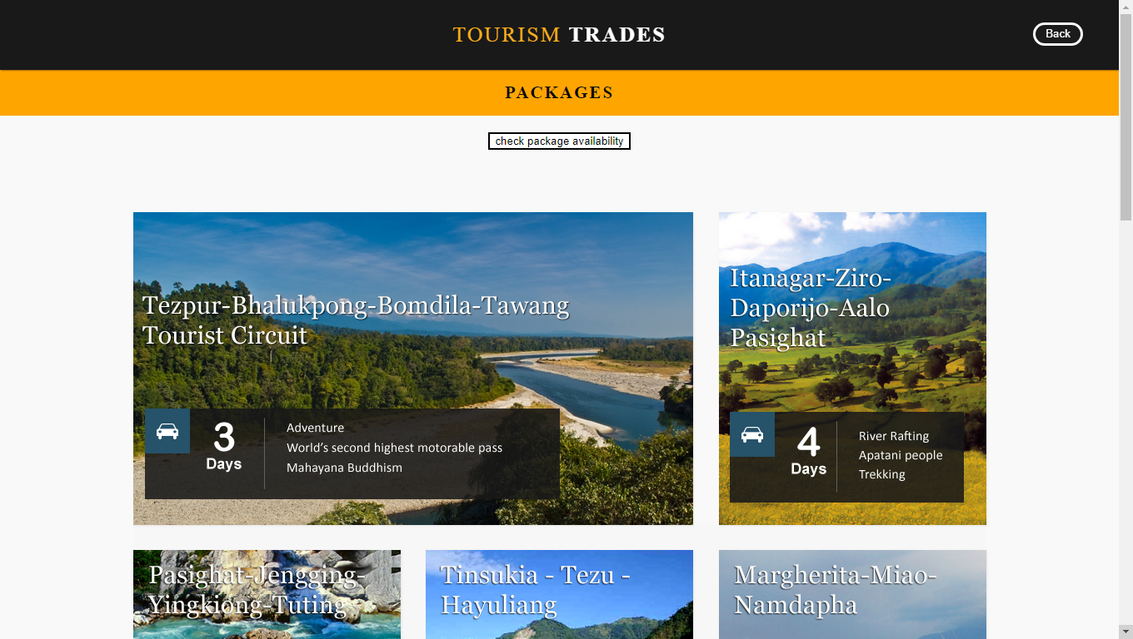
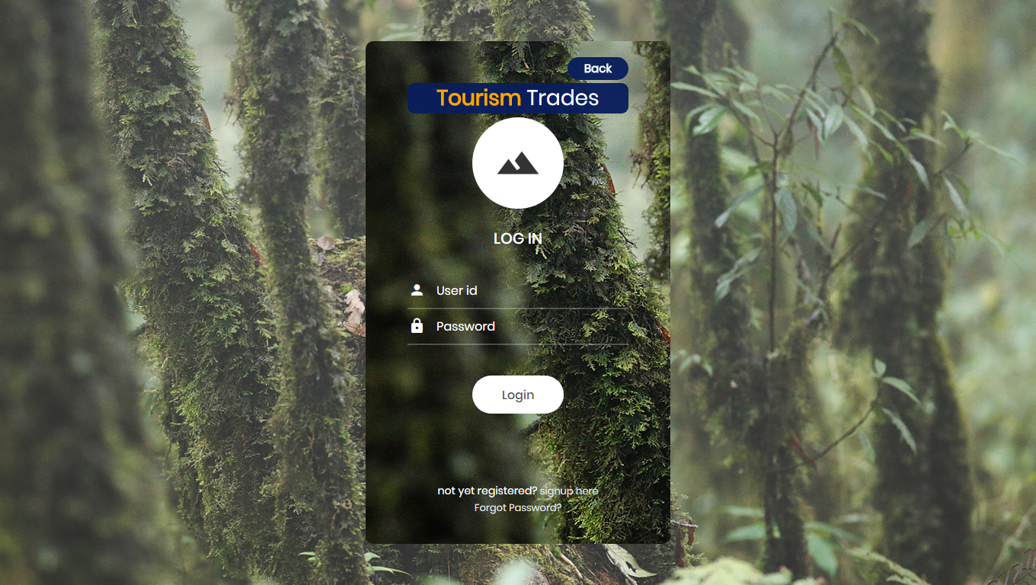
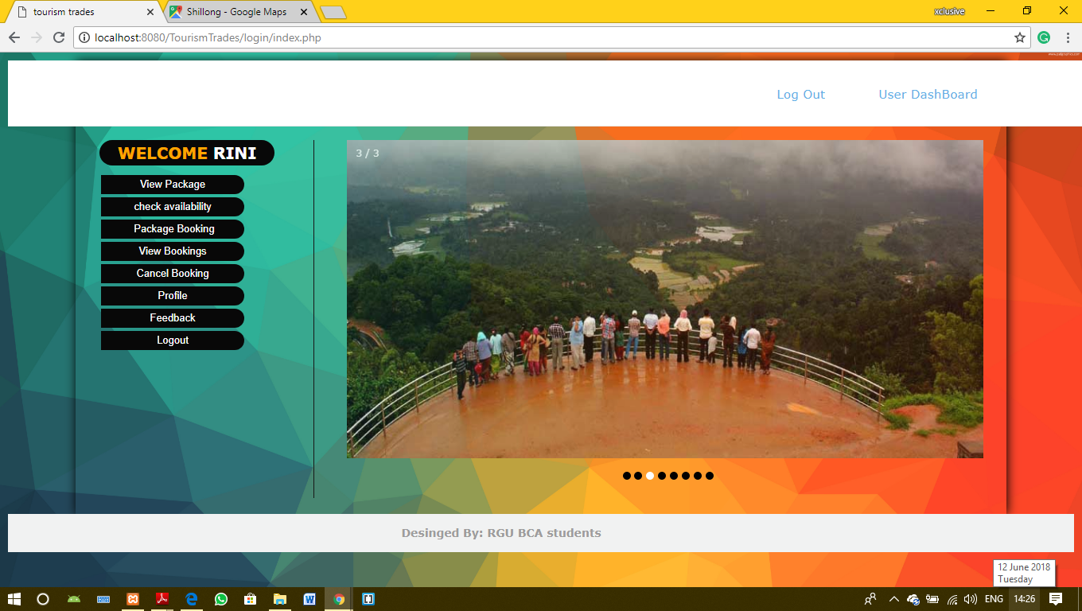
SYSTEM DESIGN

Slide 12
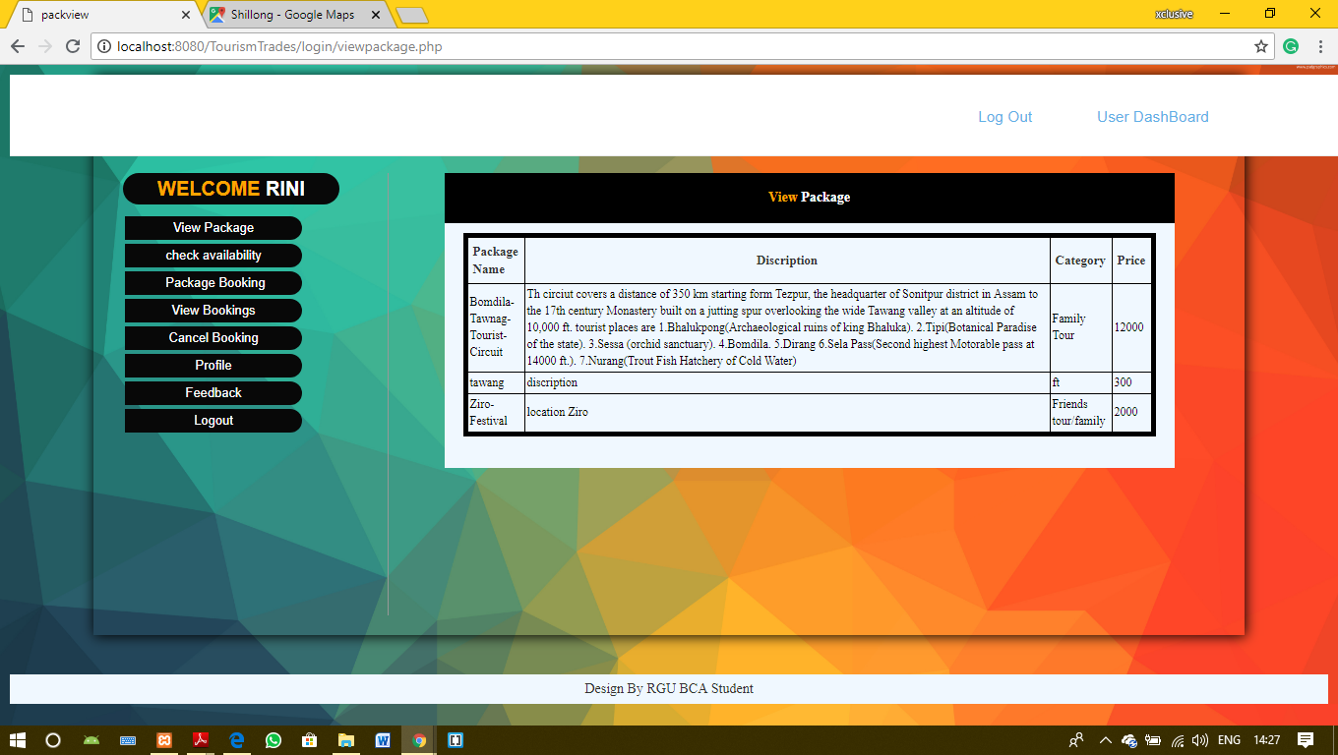
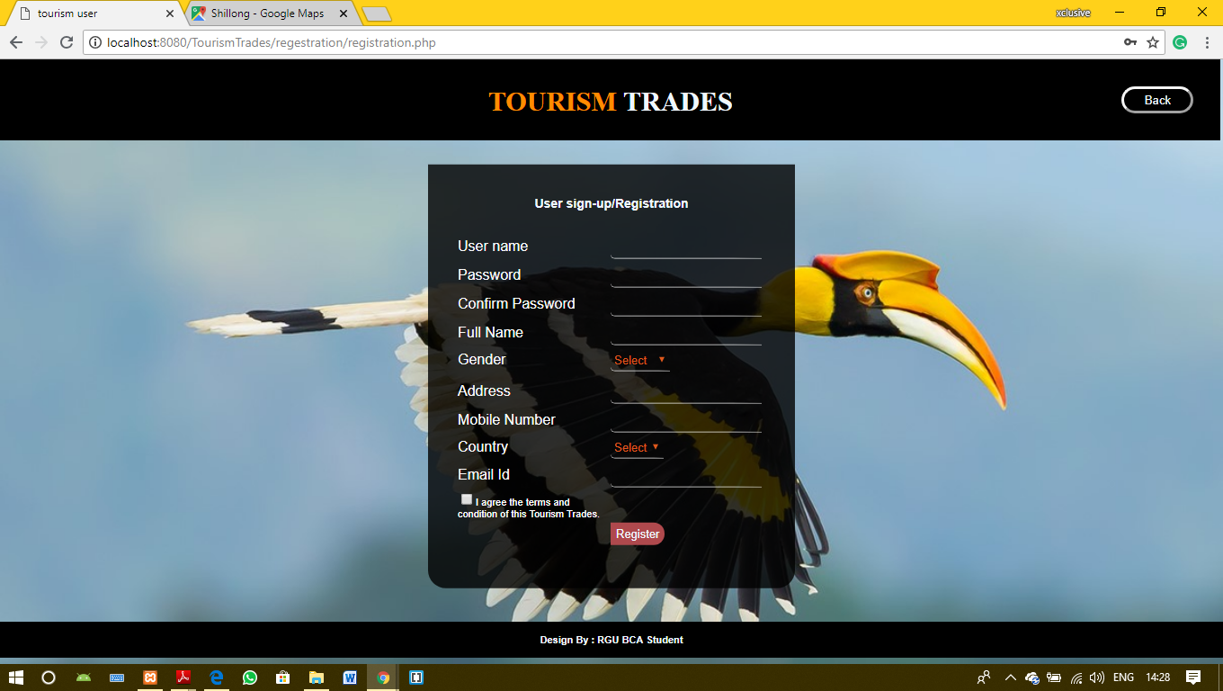
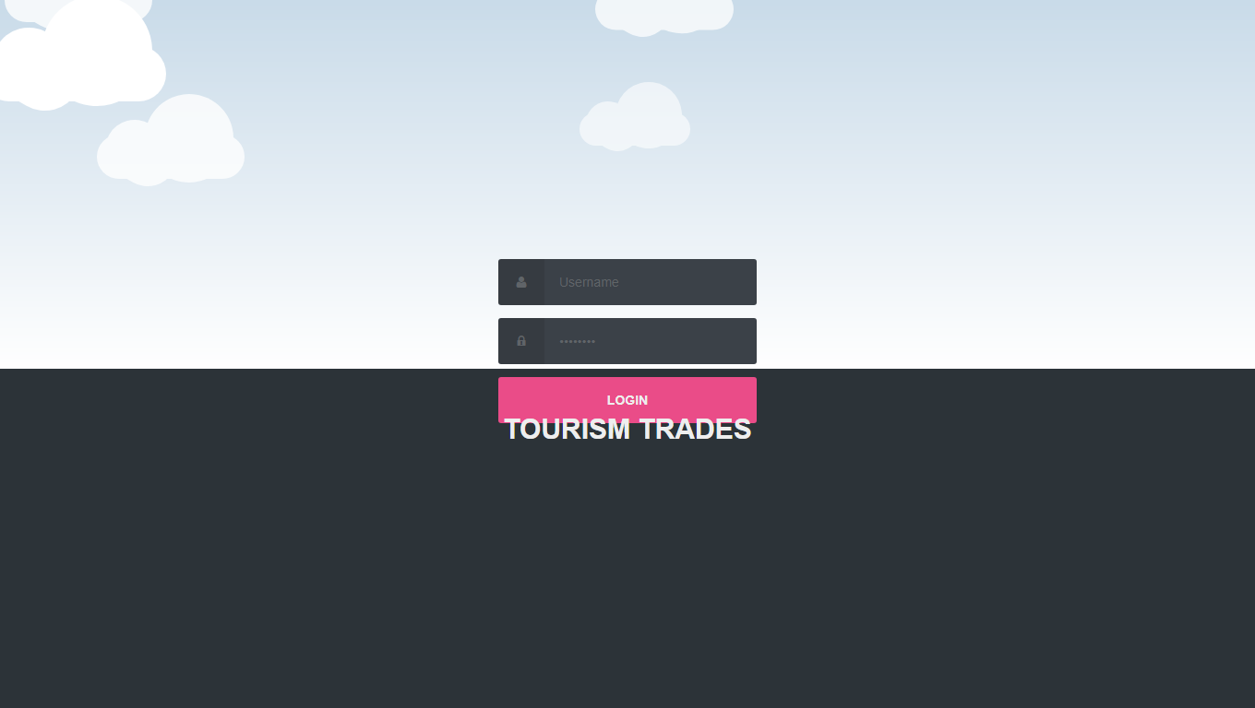
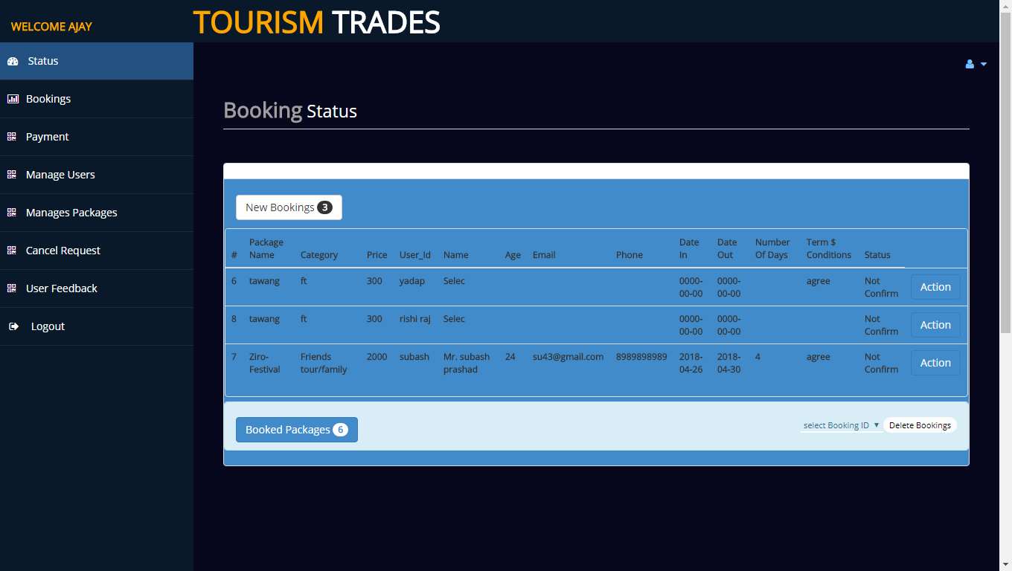
SYSTEM DESIGN

Slide 13
THANK YOU...!!!

